Slide 1
Introduction to Microbits & Network Security

Slide 2
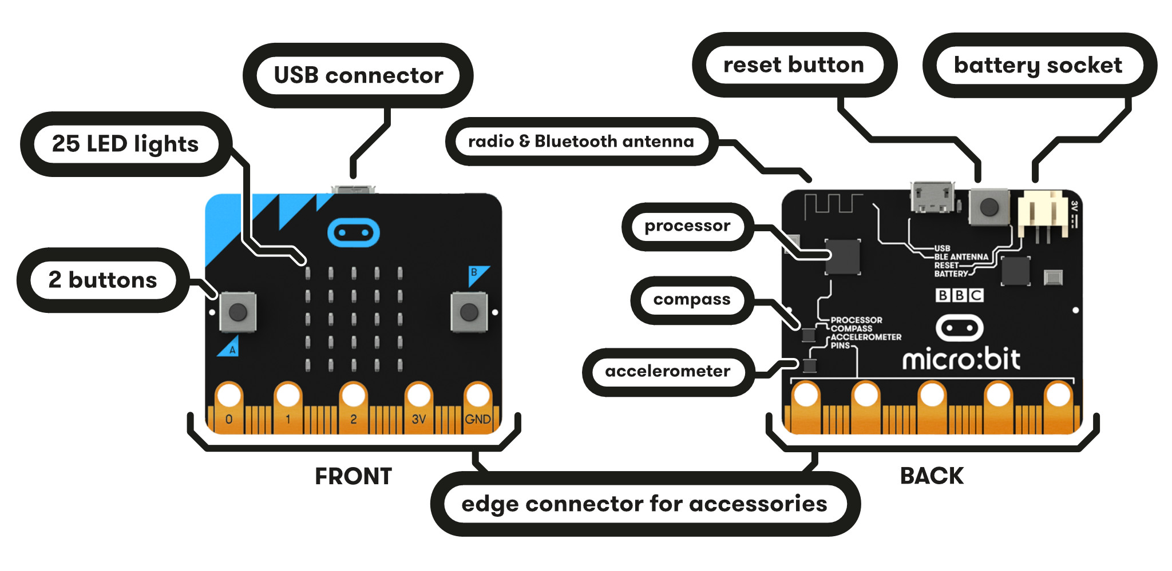
Introduction to Microbits & Network Security

Slide 3
Introduction to Microbits & Network Security
Let’s start by playing a game!

Slide 4
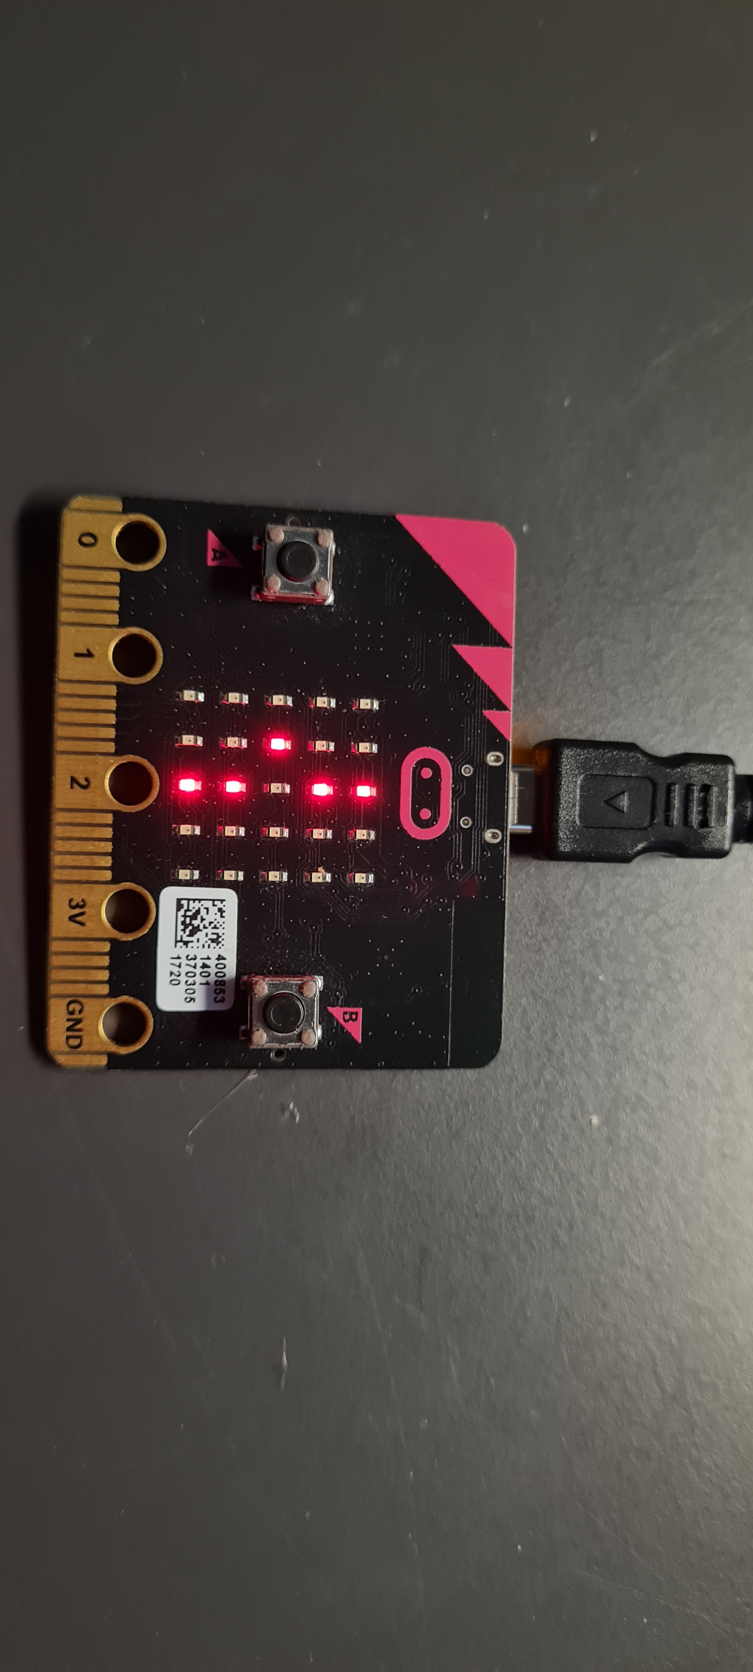
Introduction to Microbits & Network Security
Catch the dot!
> Try to catch the dot by pressing Button a
> If you press Button b, you can see your score
> Watch out, the game gets faster each time you catch the dot!

Slide 5



Introduction to Microbits & Network Security
Catch the dot… or not?
What do you notice?
Why do you think this happened?
How can we prevent this from happening again?

Slide 6
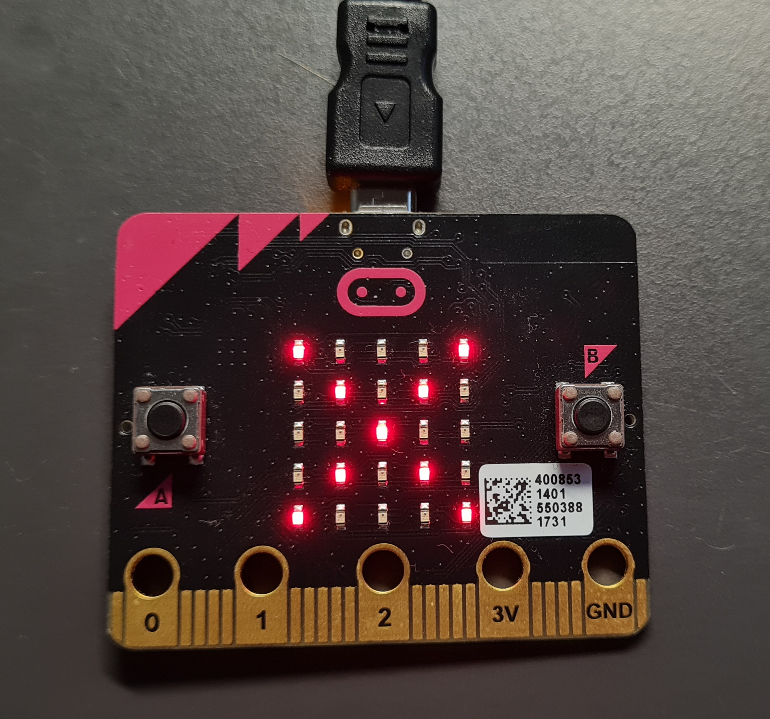
Introduction to Microbits & Network Security
Catch the dot… or not!
An intruder interrupted our game…

Slide 7
Introduction to Microbits & Network Security
Catch the dot… or not!
Our game was interrupted because the Microbit was not very well protected
We need to protect our Microbit against unauthorized access
An intruder gained access to our Microbit and was able to control it
Notes:
We have got a “Network” of Microbits – they are connected and communicate with each other
[Ghost]
Before we can work out how to protect our “Network”, we need to establish what a network is

Slide 8

Networks
What are Networks?
Why do we need Networks?

Slide 9
Introduction to Microbits & Network Security
Connected devices
Networks

Slide 10
Introduction to Microbits & Network Security
Connected devices
Networks
Devices exchange data

Slide 11
Introduction to Microbits & Network Security
Connected devices
Networks
Communication between devices
Devices exchange data

Slide 12
Introduction to Microbits & Network Security
Connection through cables
Connected devices
Networks
Communication between devices
Devices exchange data

Slide 13
Introduction to Microbits & Network Security
Wireless connection
Connection through cables
Connected devices
Networks
Communication between devices
Devices exchange data

Slide 14
Network Security
What is Network Security?
Why do we need it?

Slide 15
Introduction to Microbits & Network Security
Network Security
“Technologies, people and procedures that protect a communication infrastructure from cyberattacks and unauthorized access”

Slide 16
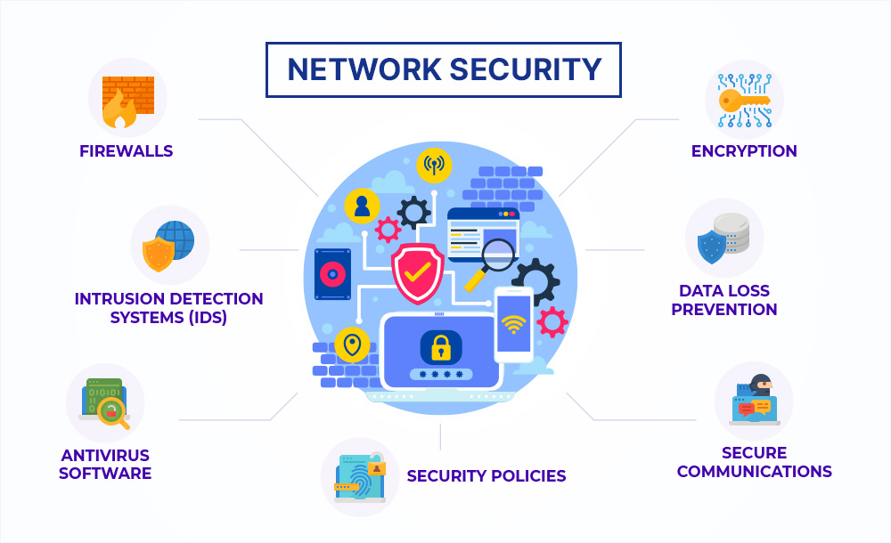
Introduction to Microbits & Network Security

Slide 17

Introduction to Microbits & Network Security
In built for most computers
Monitors ingoing and outgoing network traffic
Barrier between a trusted and un trusted network
Predetermined security rules

Slide 18
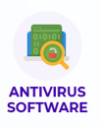
Introduction to Microbits & Network Security
Computer program to prevent, detect and remove malware
Without antivirus software, privacy and data can be compromised
Protection from different types of malware and viruses

Slide 19
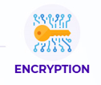
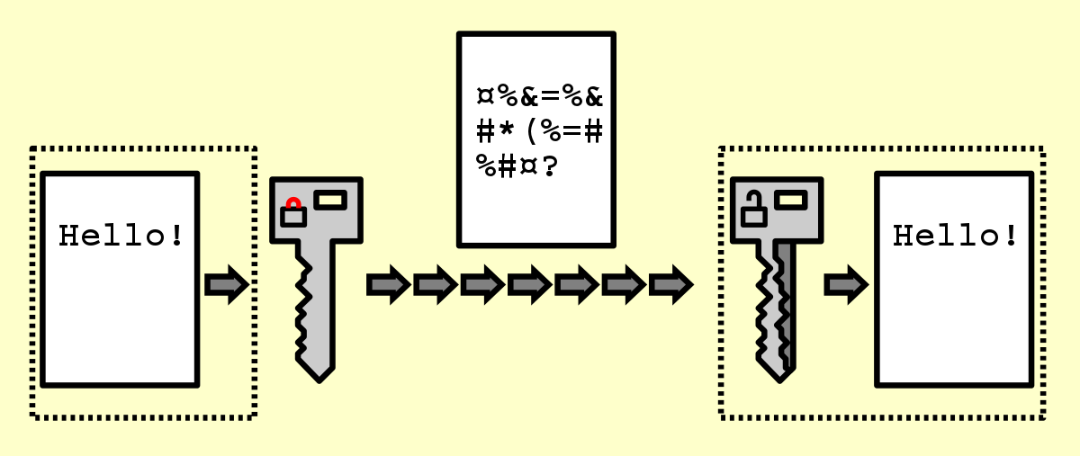
Introduction to Microbits & Network Security

Slide 20
Introduction to Microbits & Network Security
Asymmetric Encryption:
Using a public key to encrypt data
Using a private key to decrypt data
Monitors ingoing and outgoing network traffic
Symmetric Encryption:
Using a single key to en- and decrypt data
Data is changed into secret code that can only be unlocked with a special key

Slide 21

Introduction to Microbits & Network Security
Communication between two parties, which does not allow a third party to join in
Protect data
Protection from interception

Slide 22
Introduction to Microbits & Network Security
Network Security
How can we implement a security layer on our Microbit?

Slide 23
Introduction to Microbits & Network Security
Network Security
How can we implement a security layer on our Microbit?
Through access control/secure communication

Slide 24
Introduction to Microbits & Network Security
Time to get to work!

